Slide 1
LabA: Host Code Optimization
Speaker: Edan
Advisor: Prof. Jiin Lai
Date: 2022/10/20

Slide 2
Performance Optimization of HLS
Host program optimization
Schedule the tasks to increase the u-rate of kernels
Kernel code optimization
Pipeline/parallelize the kernel
Topological optimization
Connect a specific DDR to a specific kernel
Implementation optimization
DSP or LUT for the kernel
We will focus on the host program optimization

Slide 3
System Diagram
read: convert AXI to AXI_Stream
write: convert AXI_Stream to AXI
exec: add processDelays to the input and write out the result after processDelays cycles

Slide 4
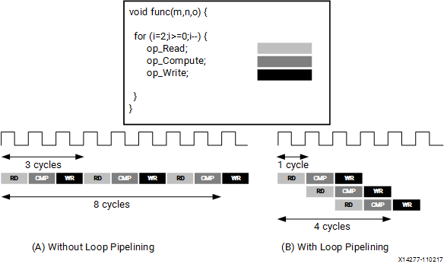
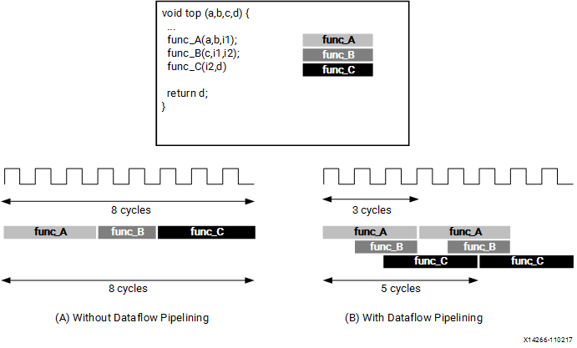
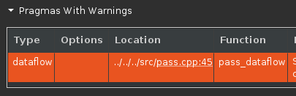
Used Pragma
PIPELINE
Reduces the II into 1 as possible
Depends on the read and write latency
How many copies of HW required
DATAFLOW
Enable task-level pipelining
Especially for adjacent for loops
Also reduce the II of the entire function
Not working in current example
Shown in the result

Slide 5
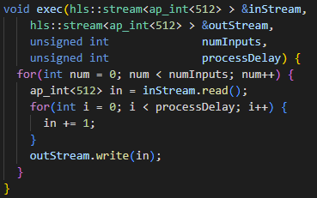
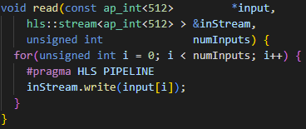
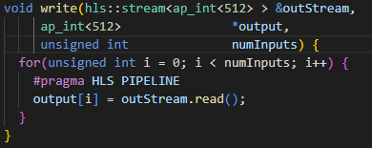
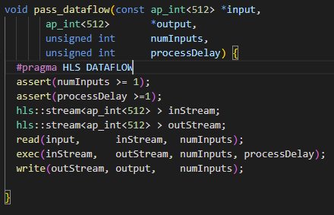
Code of Module-pass
read
write
exec
pass_dataflow

Slide 6
Host Program
Flow chart
ApiHandle
Setup device
Create kernel
Create queue
Task
Create global buffer for input and output
Set kernel args
Move input data to global buffer
Start kernel
Read output data from the global buffer

Slide 7
Current Settings
numBuffers
Total number of tasks
Set to 10 in the first and 100 in the second task
oooQueue
Set the queue as the out-of-order queue
Set to true except the first experiment of Lab1
processDelay
The number required to be added to the output
Set to 1
bufferSize
The number of input data per task
Set as 16384 in the first two labs and sweep in the third lab

Slide 8
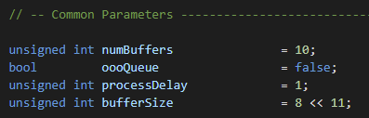
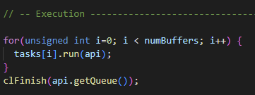
Lab1: Use the In-order Queue
Setup params
Execution code

Slide 9
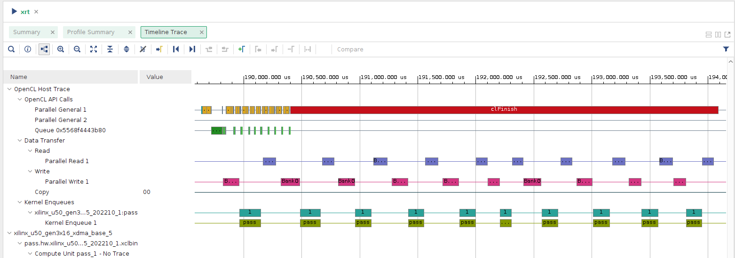
Lab1: Use the In-order Queue
Timeline
Total execution time: 0.043s

Slide 10
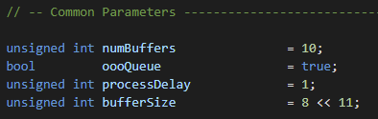
Lab1: Use the Out-of-order Queue
Setup params
Execution code

Slide 11
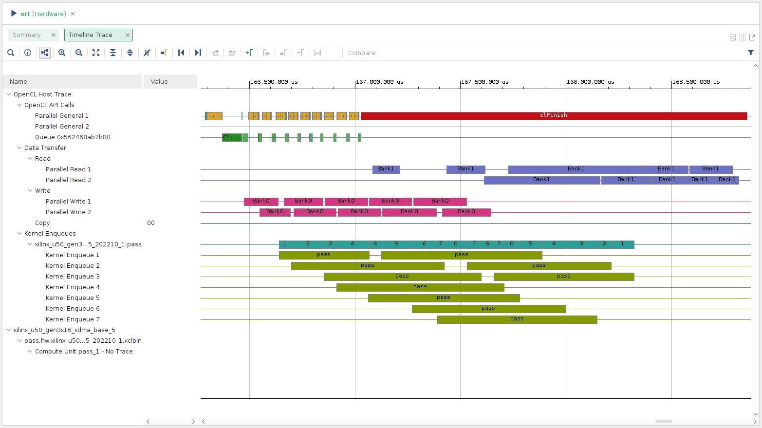
Lab1: Use the In-order Queue
Timeline
Total execution time: 0.043s → 0.024s

Slide 12
Observation
The execution of one pass is longer in oooqueue
Longer latency per task
Problem in the current design
No synchronization until the end
If the numBuffers is too large → FPGA will consume too much host memories, which can only be released at the end of the program.

Slide 13
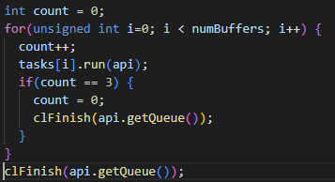
Lab2: Kernel and Host Code Synchronization
OpenCL framework has two methods for synchronization
clFinish and clWaitForEvents
Modify the execution section

Slide 14
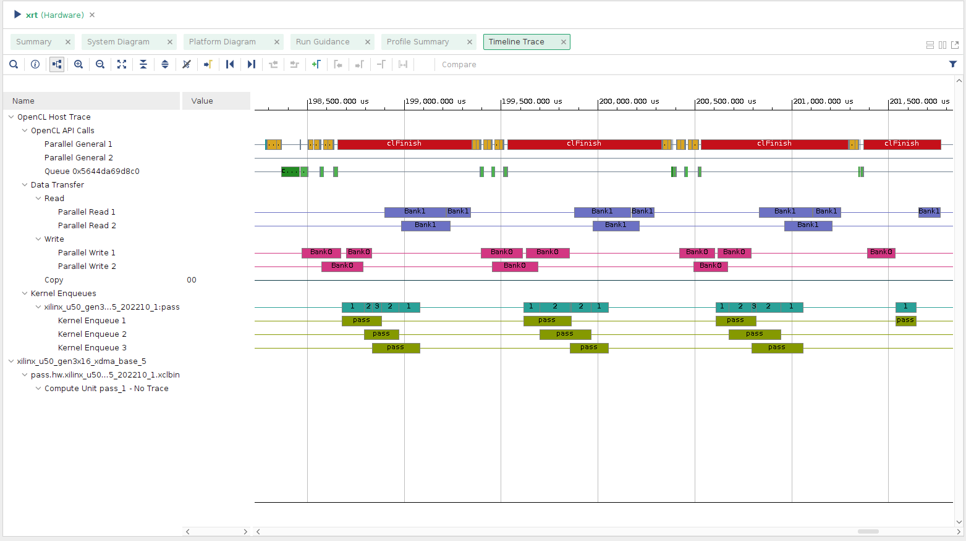
Lab2: Kernel and Host Code Synchronization
Timeline
Total execution time: 0.024s → 0.033s

Slide 15
Observation
It is like a trade-off between in-order-queue and out-of-order queue
Out-of-order inside a batch, in-order between batches
The clFinish is the synchronization point of the host program
Called four times in Lab2

Slide 16
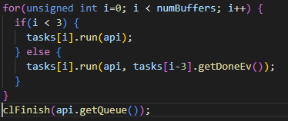
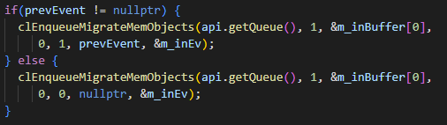
Lab2: Kernel and Host Code Synchronization
We can let the current task depends on the finish of the previous task
Execution code

Slide 17
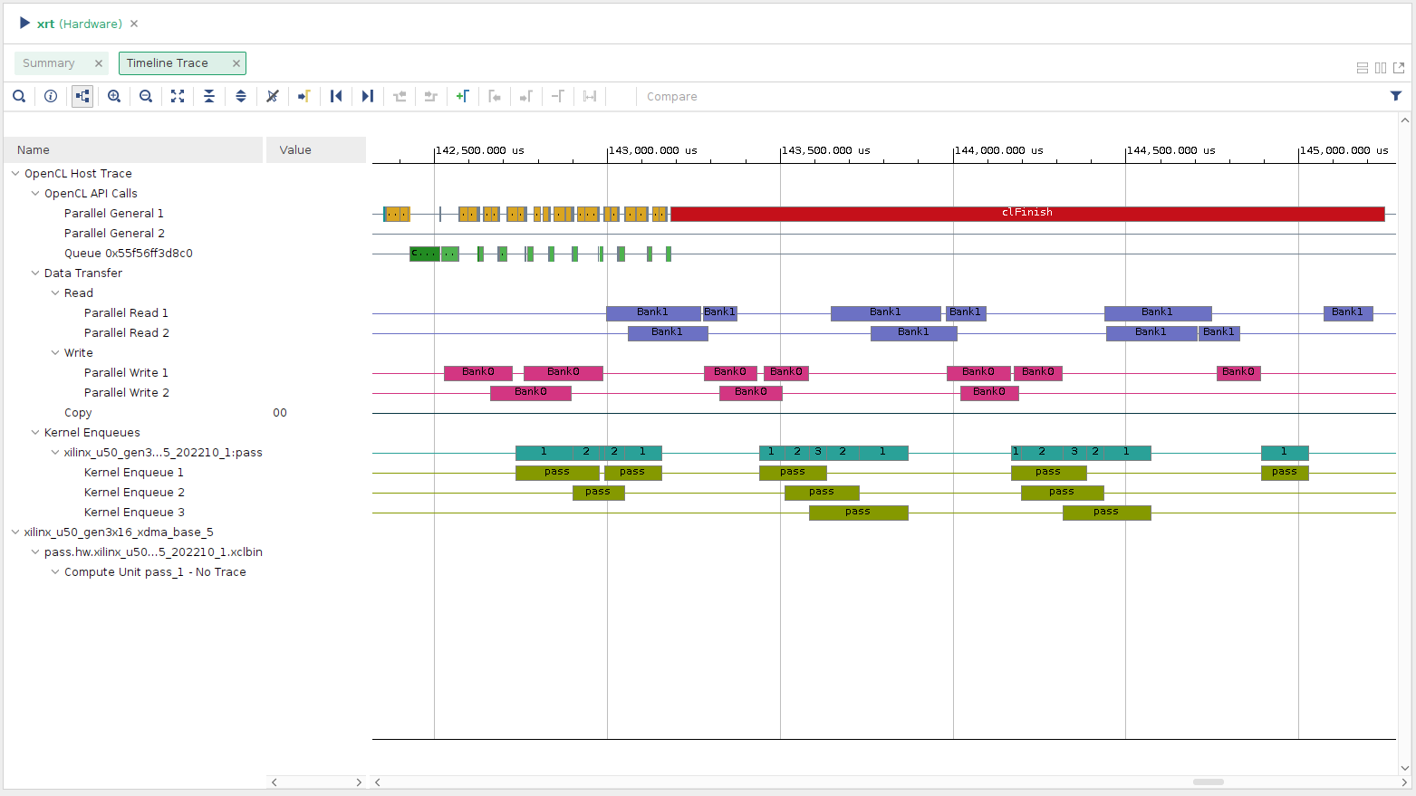
Lab2: Kernel and Host Code Synchronization
Timeline
Total execution time: 0.033s → 0.027s
More overlap reduce execution time

Slide 18
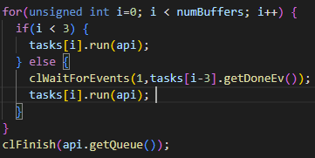
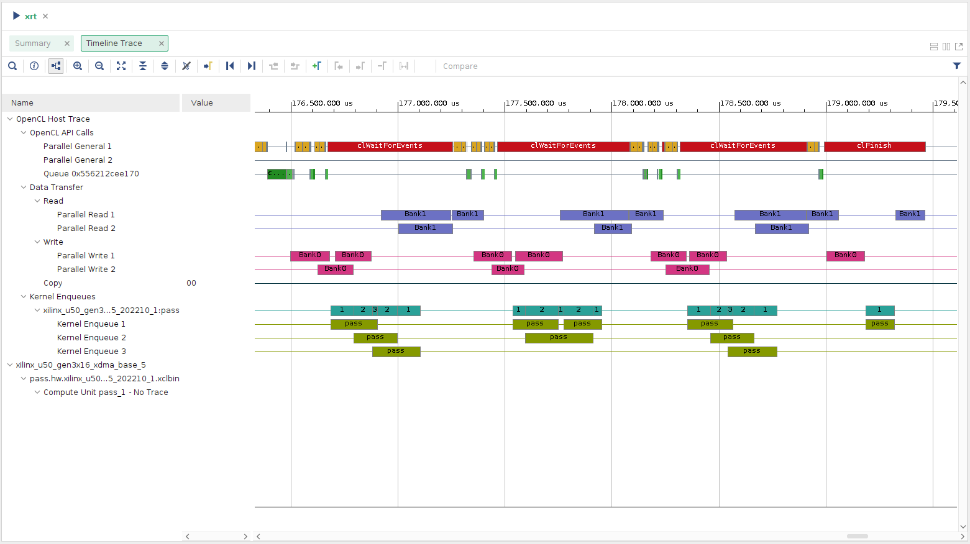
Lab2: Kernel and Host Code Synchronization
Using clWaitForEvent
Timeline

Slide 19
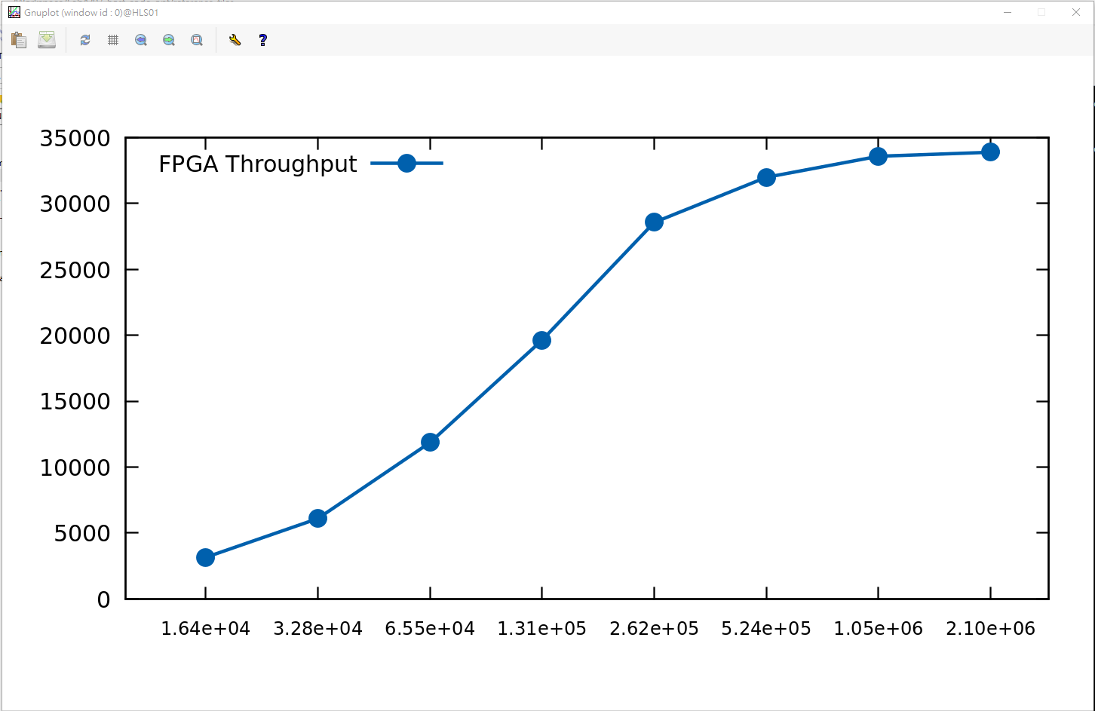
Lab3: OpenCL API Buffer Size
Set numBuffer to 100 to get a more accurate average throughput estimate per transfer
We then sweep the buffer size from 2¹⁴ to 2²¹ to observe the change of the throughput
Saturate when buffer size is close to 2²⁰
The saturated throughput is approximate 34000Mb/s

Slide 20
Summary
Host code indeed influences the execution time and resource usage
Good host code make your kernel highly utilized without occupy too many host resources
The final sweep of the buffer size indicates the proper buffer size to use in our system to make the interface fully utilized

Slide 21
Q&A
How to release the buffer occupied by the host code?
Insert clFinish
Insert clWaitForEvent
Let event depends on the finish of the previous event

